Slide 1
Meowtion
UX / UI
#HACKTHEKITTY 2026
Notes:
Now we can see how the user interacts with the collar and the data using the online dashboard

Slide 2
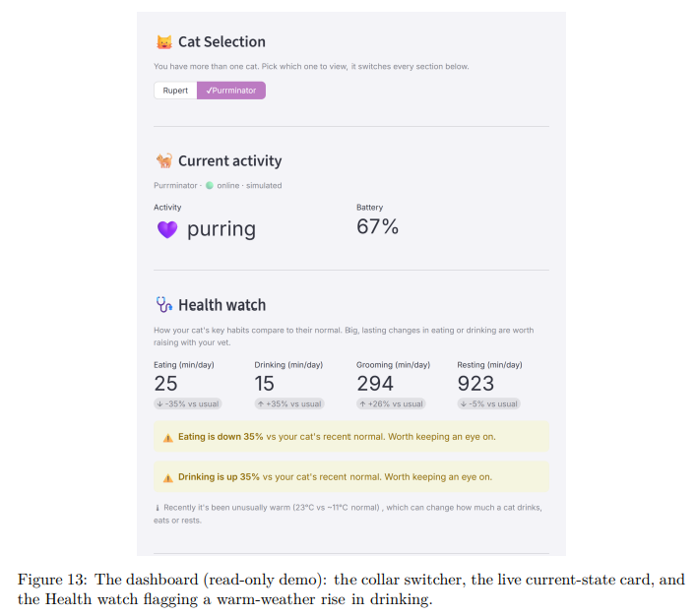
Meowtion
#HACKTHEKITTY 2026
Notes:
the human facing application is a dashboard built with Streamlit

Slide 3
Meowtion
#HACKTHEKITTY 2026
Notes:
a python framework for data web apps

Slide 4
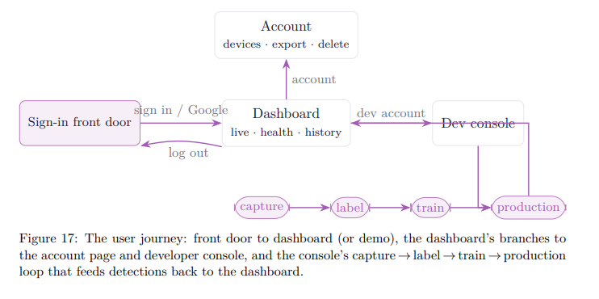
Meowtion
#HACKTHEKITTY 2026
Notes:
It is made of 2 parts

Slide 5
Meowtion
#HACKTHEKITTY 2026
Notes:
developer console where the training data is collected and models are trained

Slide 6
Meowtion
#HACKTHEKITTY 2026
Notes:
and the dashboard where the data is visualised and contextualised

Slide 7
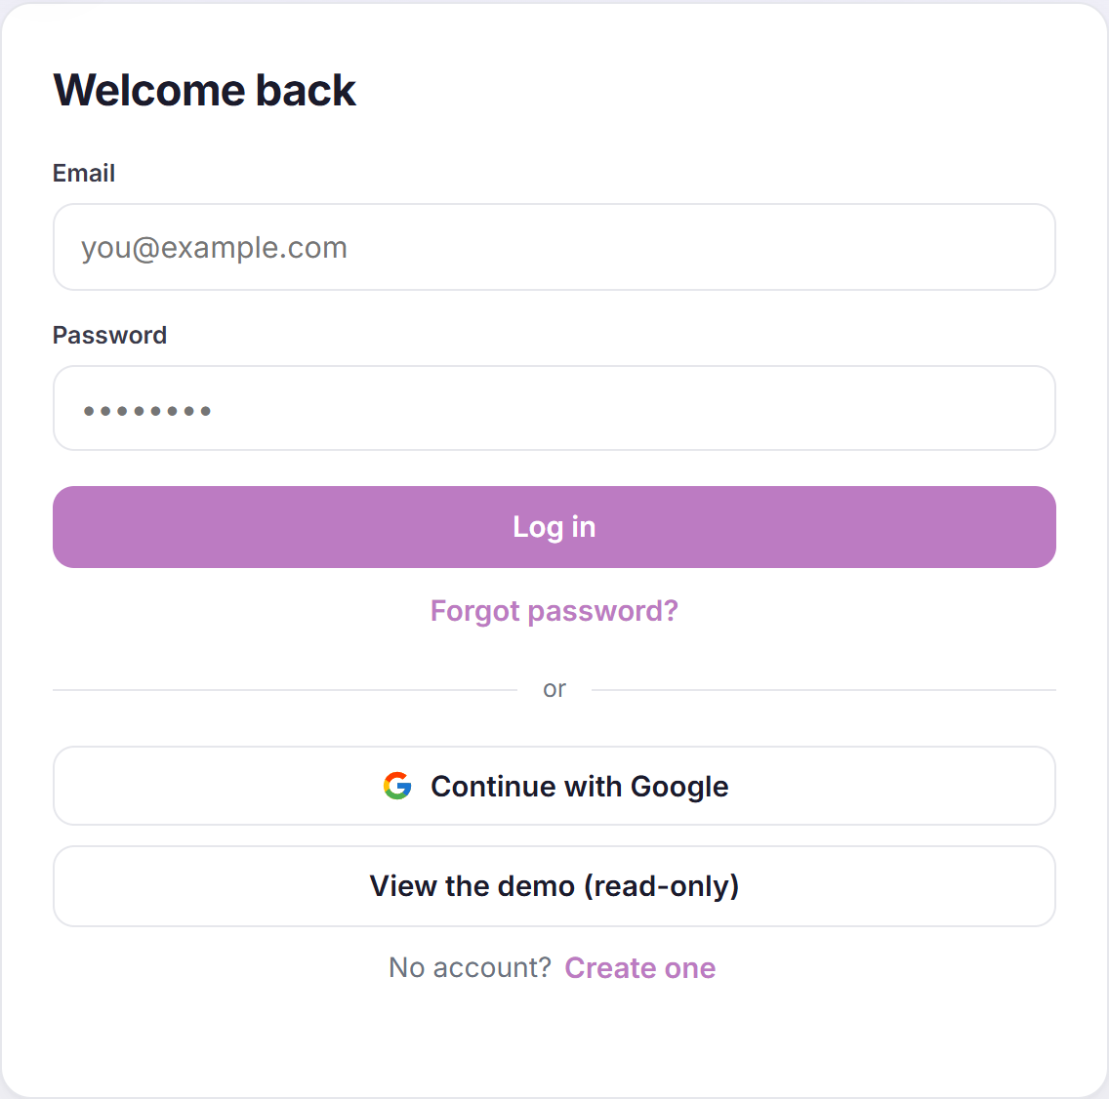
Meowtion
#HACKTHEKITTY 2026
Notes:
Human logs in either email or demo mode

Slide 8
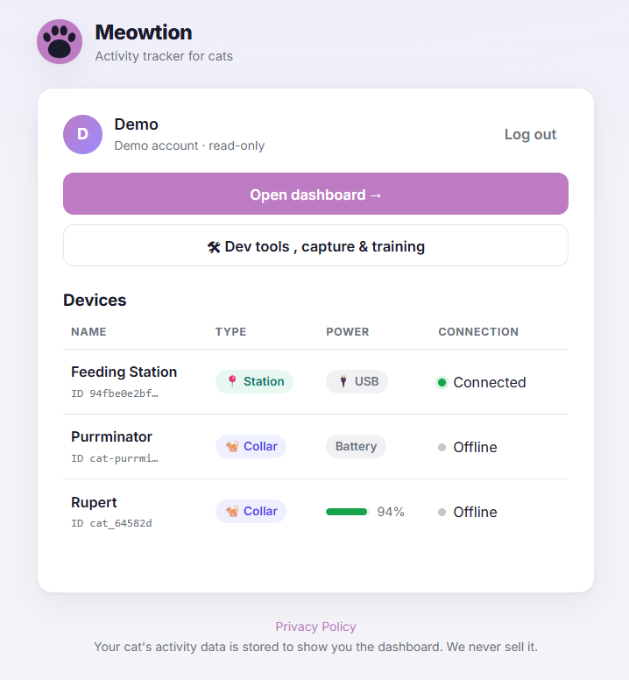
Meowtion
#HACKTHEKITTY 2026
Notes:
And can choose between dashboard or dev tools, with registered devices clearly listed

Slide 9
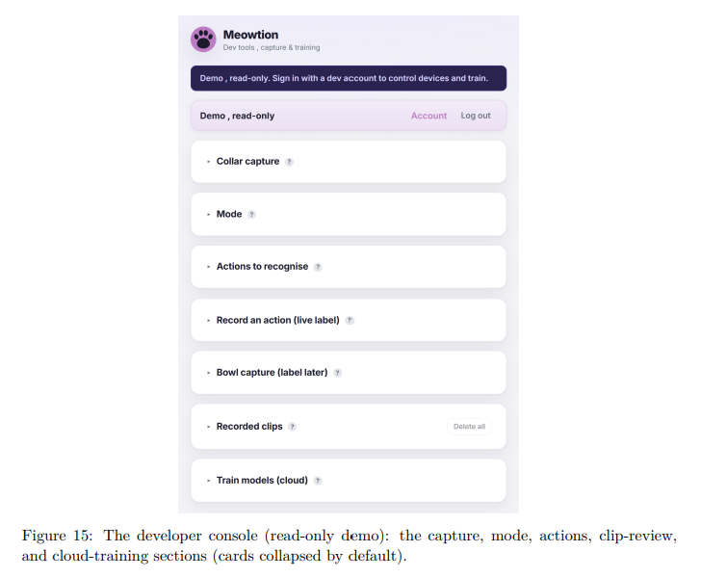
Meowtion
#HACKTHEKITTY 2026
Notes:
In dev tools, the developer console is organised as clearly titled collapsible cards each with a help popover

Slide 10
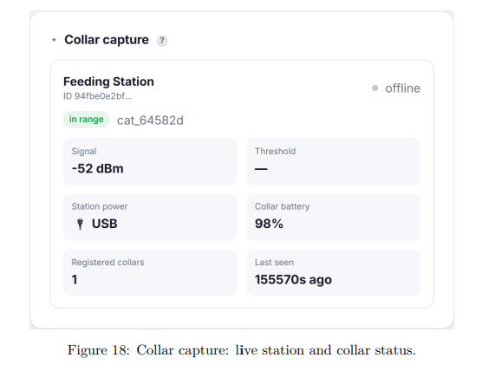
Meowtion
#HACKTHEKITTY 2026
Notes:
the collar capture clearly shows live station and collar status

Slide 11
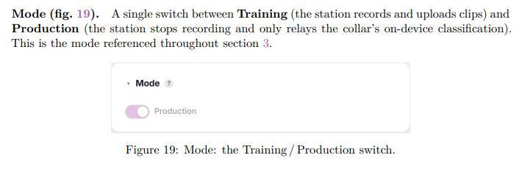
Meowtion
#HACKTHEKITTY 2026
Notes:
and a single switch takes human from training to production mode

Slide 12
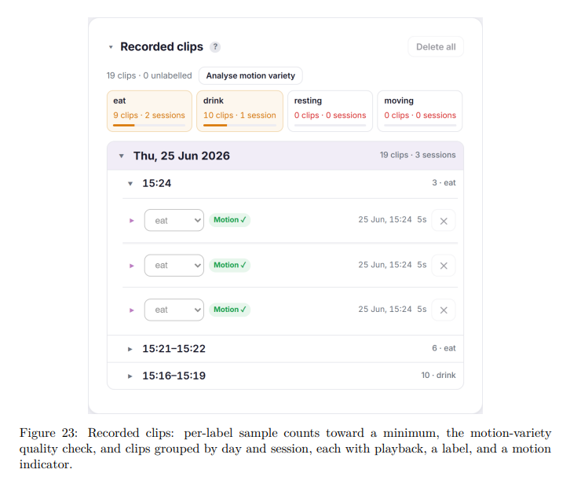
Meowtion
#HACKTHEKITTY 2026
Notes:
this is where the recorded clips wait to be classified, grouped by day and session

Slide 13
Meowtion
#HACKTHEKITTY 2026
Notes:
each with playback

Slide 14
Meowtion
#HACKTHEKITTY 2026
Notes:
A label

Slide 15
Meowtion
#HACKTHEKITTY 2026
Notes:
and a motion indicator

Slide 16
Meowtion
#HACKTHEKITTY 2026
Notes:
pause

Slide 17
Meowtion
#HACKTHEKITTY 2026
Notes:
When human checks the dashboard they can immediately see which kitty,

Slide 18
Meowtion
#HACKTHEKITTY 2026
Notes:
the current activity

Slide 19
Meowtion
#HACKTHEKITTY 2026
Notes:
and battery status

Slide 20
Meowtion
#HACKTHEKITTY 2026
Notes:
When they look at health watch

Slide 21
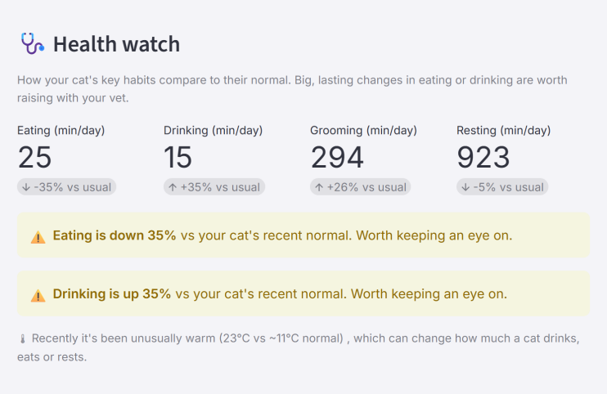
Meowtion
#HACKTHEKITTY 2026
Notes:
They can see an overview of kitty’s main activities

Slide 22
Meowtion
#HACKTHEKITTY 2026
Notes:
And how it compares to their usual routine

Slide 23
Meowtion
#HACKTHEKITTY 2026
Notes:
If its hot, human wants to know kitty is drinking enough water

Slide 24
Meowtion
#HACKTHEKITTY 2026
Notes:
Or if kitty is getting a second breakfast

Slide 25
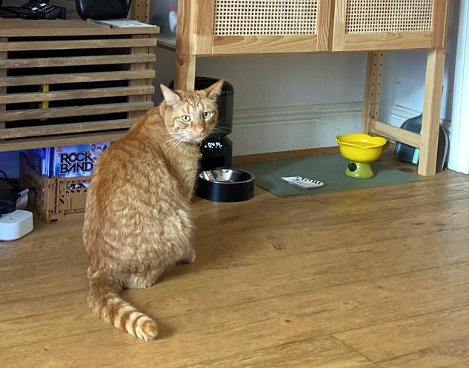
Meowtion
#HACKTHEKITTY 2026
Notes:
pause

Slide 26
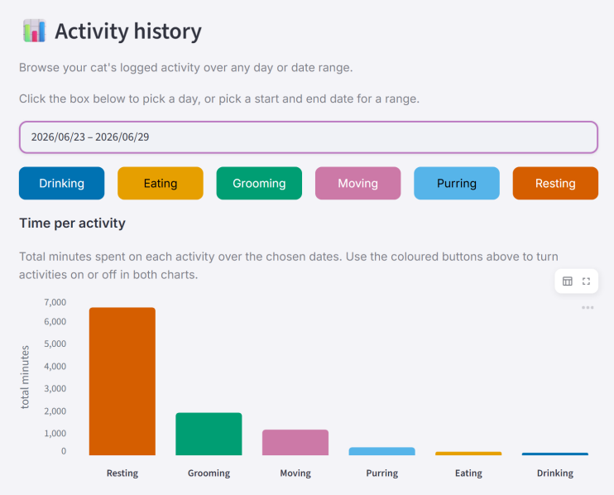
Meowtion
#HACKTHEKITTY 2026
Notes:
the activity history lets human pick a date range and view kitty’s routine by activity

Slide 27
Meowtion
#HACKTHEKITTY 2026
Notes:
human picks date ranges using a calendar and toggle buttons to easily select which activity to filter by

Slide 28
Meowtion
#HACKTHEKITTY 2026
Notes:
and the zoomable rows of days activity timeline dynamically changes the x and y axis depending on the range selected

Slide 29
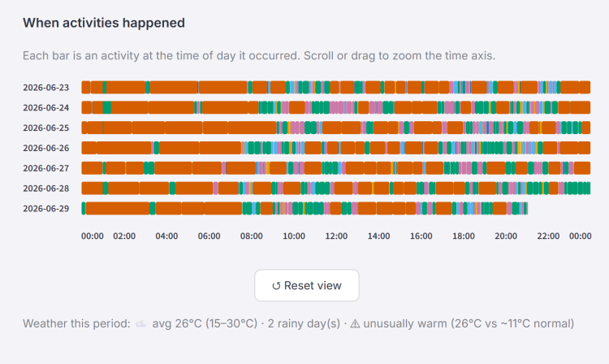
Meowtion
#HACKTHEKITTY 2026
Notes:
useful to help see trends over time or investigate a particular change with a vet

